Slide 1

Reddit
Presented by Bunea
A presentation about

Slide 2
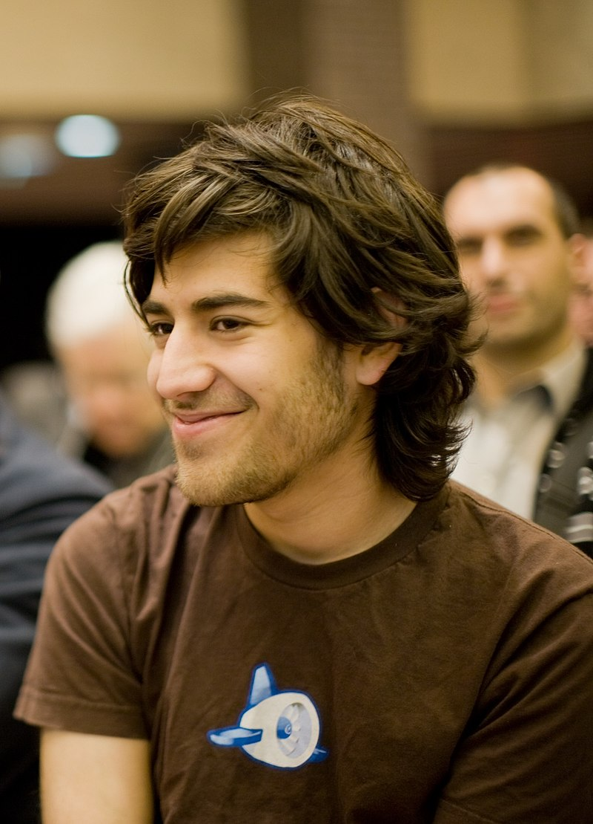
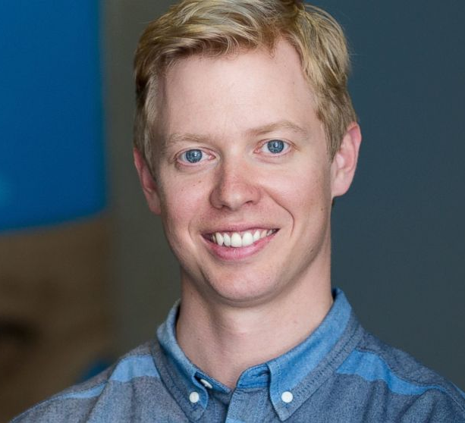
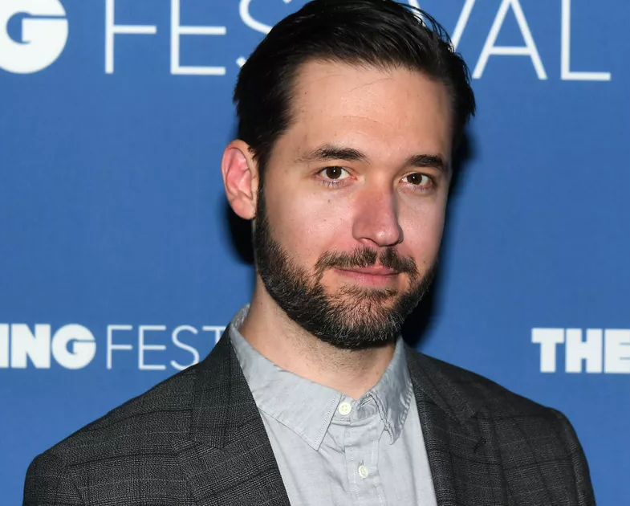
Founded ON june 23rd 2005
Steve Huffman
aka u/spez
Current CEO of Reddit
Aaron Schwartz
Alexis Ohanien

Slide 3

What is reddit?
A news site
A forum
A social media

Slide 4

Why is reddit?
creation of reddit
App for ordering food via SMS
Idea was rejected by Y Combinator
Idea: “The front page of the internet”

Slide 5
Subreddits

Slide 6
Popularity
1.5 Billion visits per month from around the world
42% of user are from the US
52 million daily active users

Slide 7



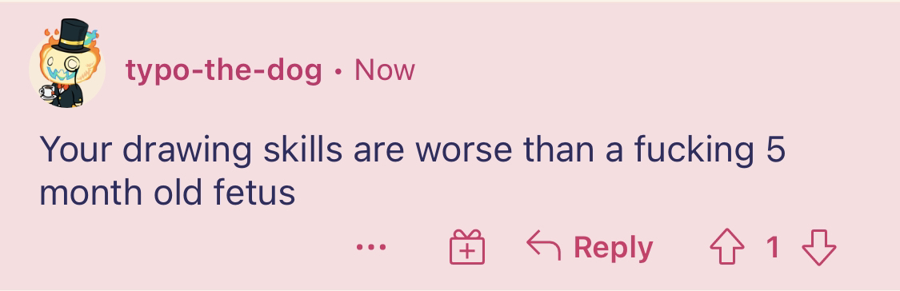
Some people are nice

Slide 8
Some notable stuff from reddit
I’m running out of ideas.

Slide 9
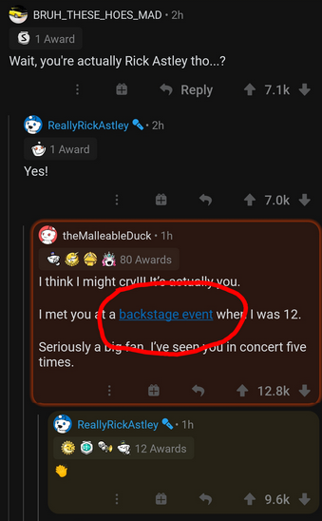

Rick Astley gets rick rolled

Slide 10
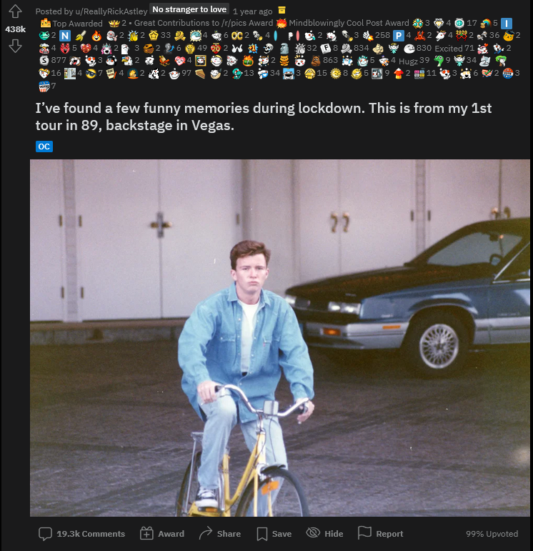
Most upvoted reddit post
438k upvotes
A bunch of rewards

Slide 11
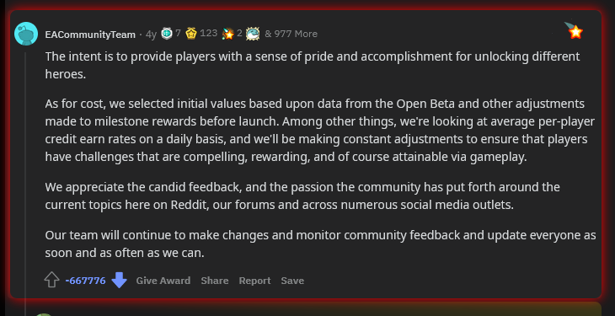
Most downvoted reddit post
667k Downvotes

Slide 12

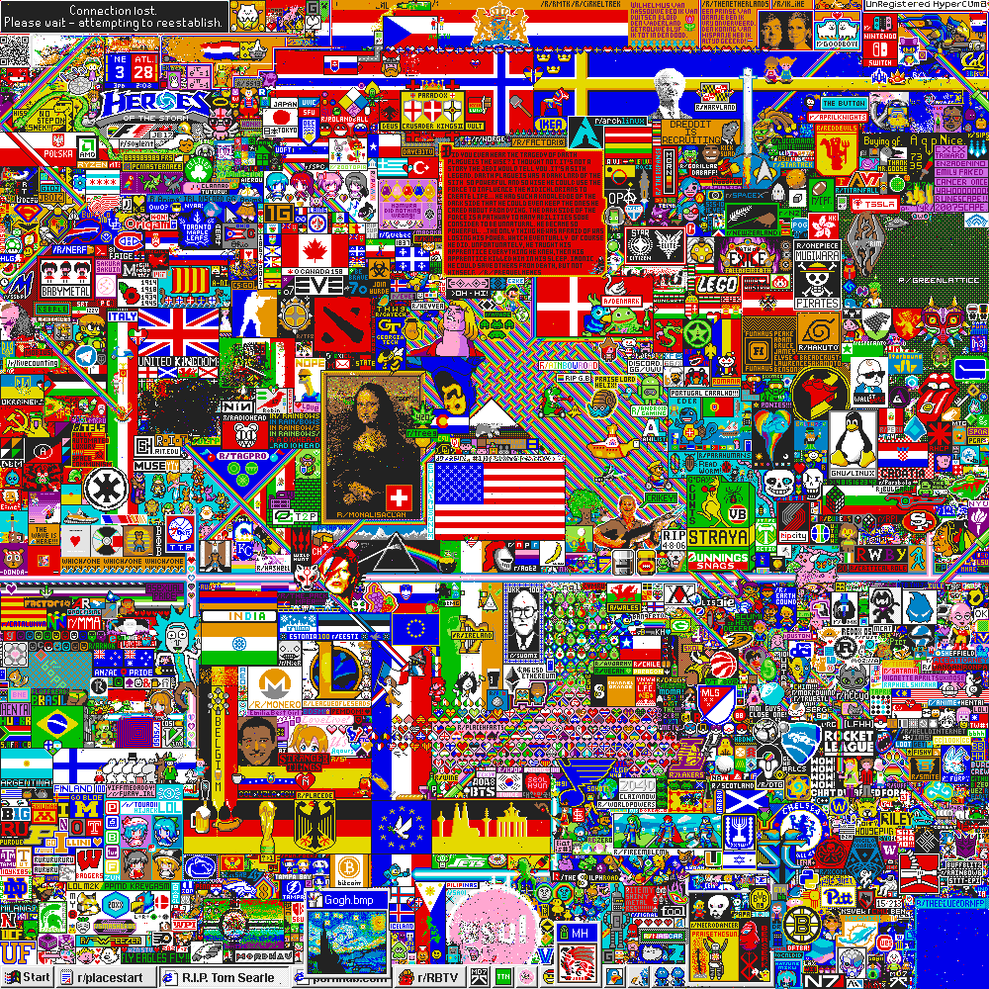

Reddit hosts annual April fools' events

Slide 13











r/place

Slide 14
Do I recommend reddit?
Eh yeah sure
I guess

Slide 15



The End

